Slide 1
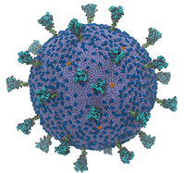
Big Data Platforms
Covid 19 – Israel analysis
Group members:
Ilan Schaedel id 011708005 Moty Marom 025372830

Slide 2
The Problem
Representing and visualizing time series data of a time-based event in progress
Finding where there is a better chance to survive a pandemic in future cases

Slide 3
The Solution
The project shall analyze data from Israel CBS regarding Covid 19 outbreak, socio demographic data, geo-based data
The goal of the project is to find the correlations between:
Social demographic laddering and chances to survive the next pandemic or next Covid 19 outbreak
Where is a safer place to live in populated cities close to a medical facility or in a less dense area but farther away from professional medical care

Slide 4
Difference
The difference between our solution and previous solutions is the usage of different methods to analyze the data and different assumptions to representing of the data to methods used
Segmentation of geographical data
Use of different graphic representations
Use of Israel data set

Slide 5
Method
Data collection
Collect data
Data cleaning
Remove missing & outliers, format text
Aggregate different data sets
Aggregate
Create the correct connections between datasets
Define relevant data
analyze
implementing statistical methods as mean, std, correlation etc.
Visualize
visualizing data and insights

Slide 6
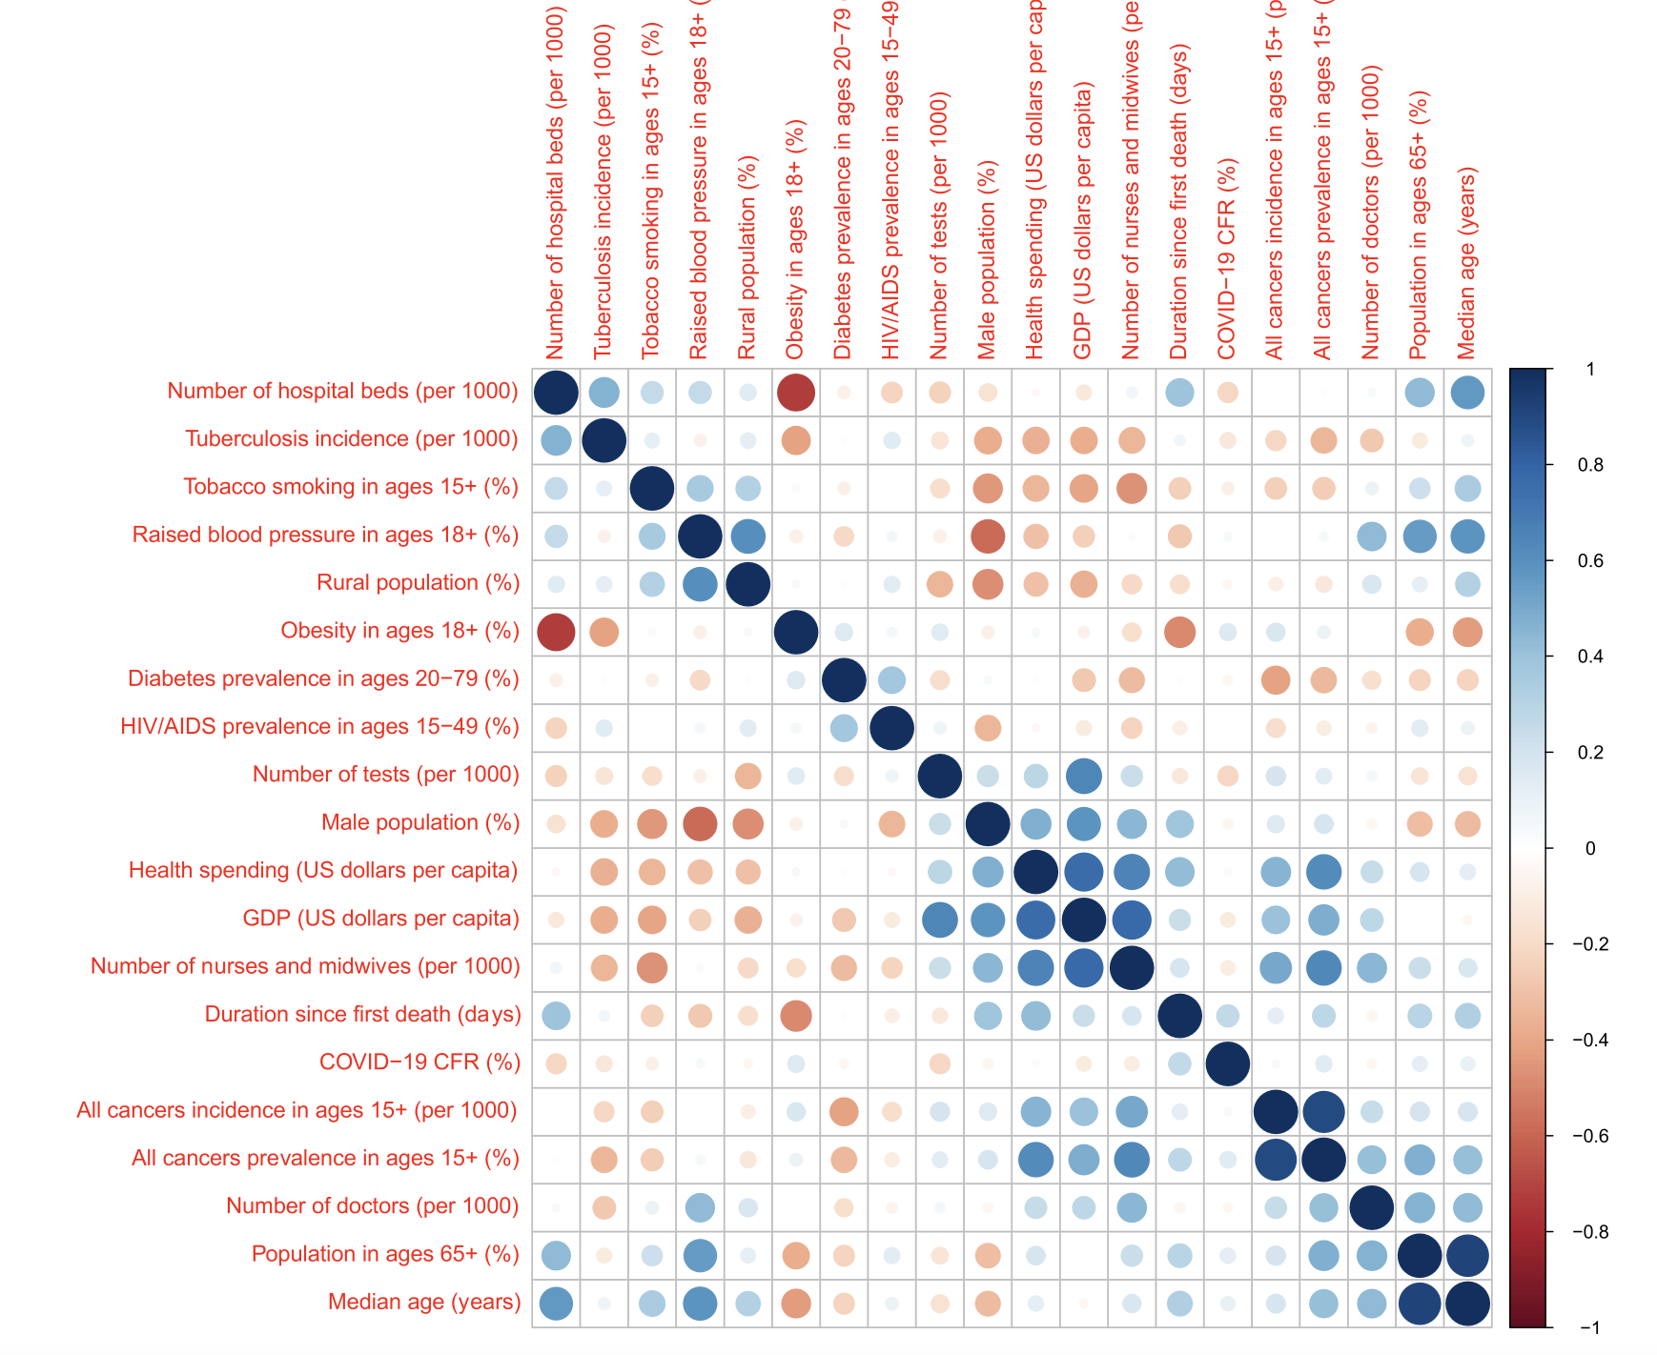
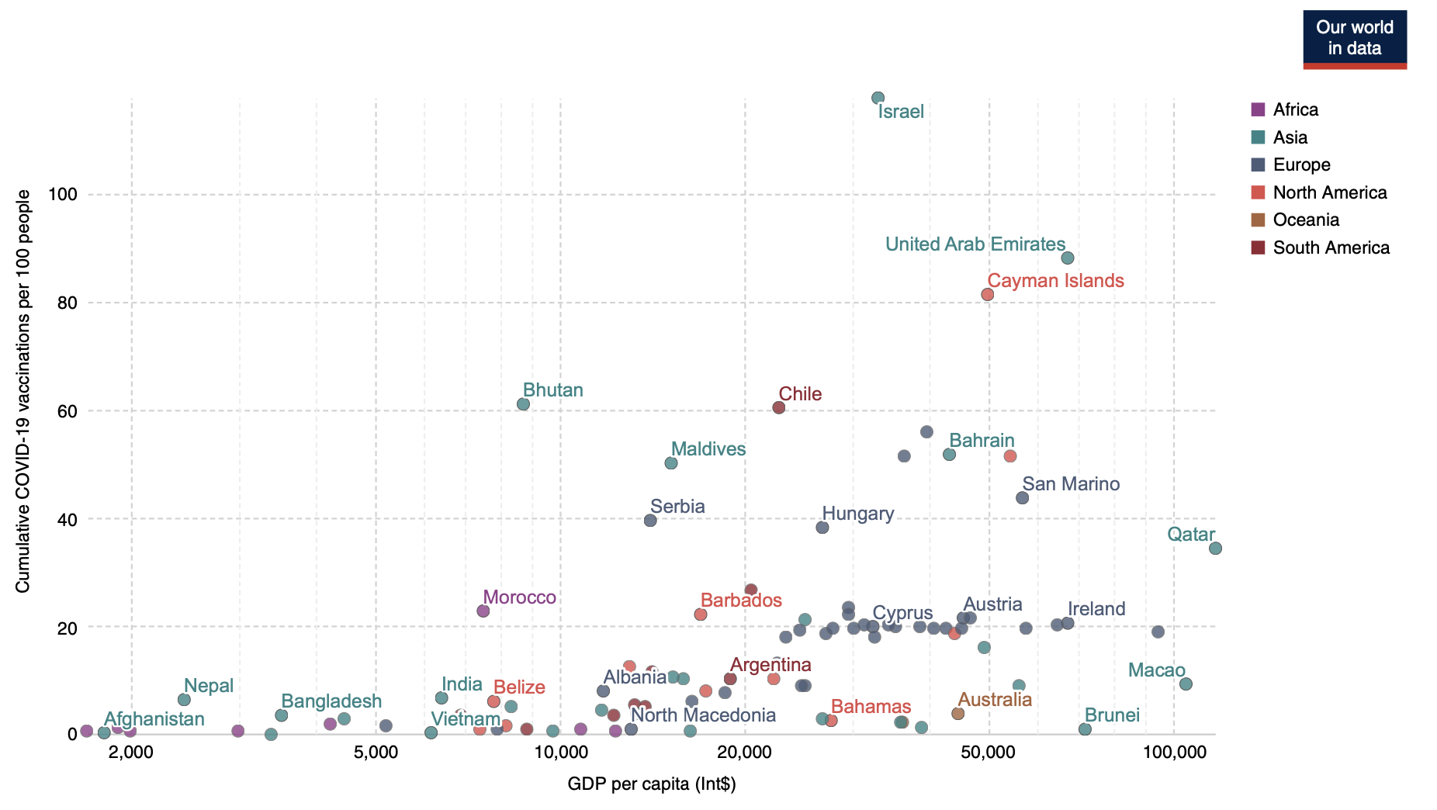
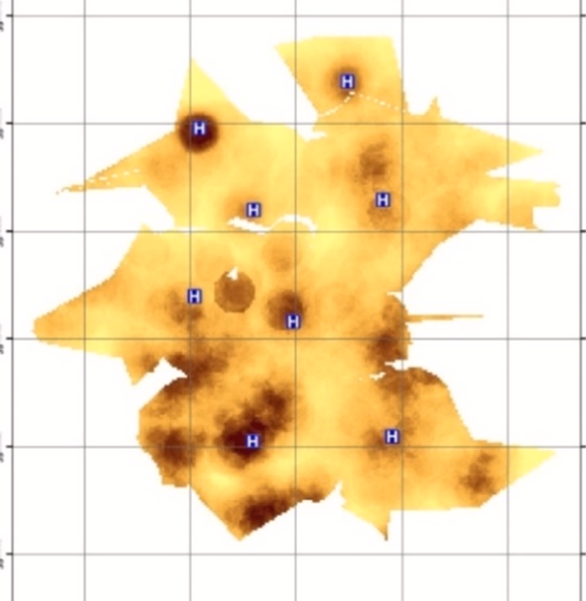
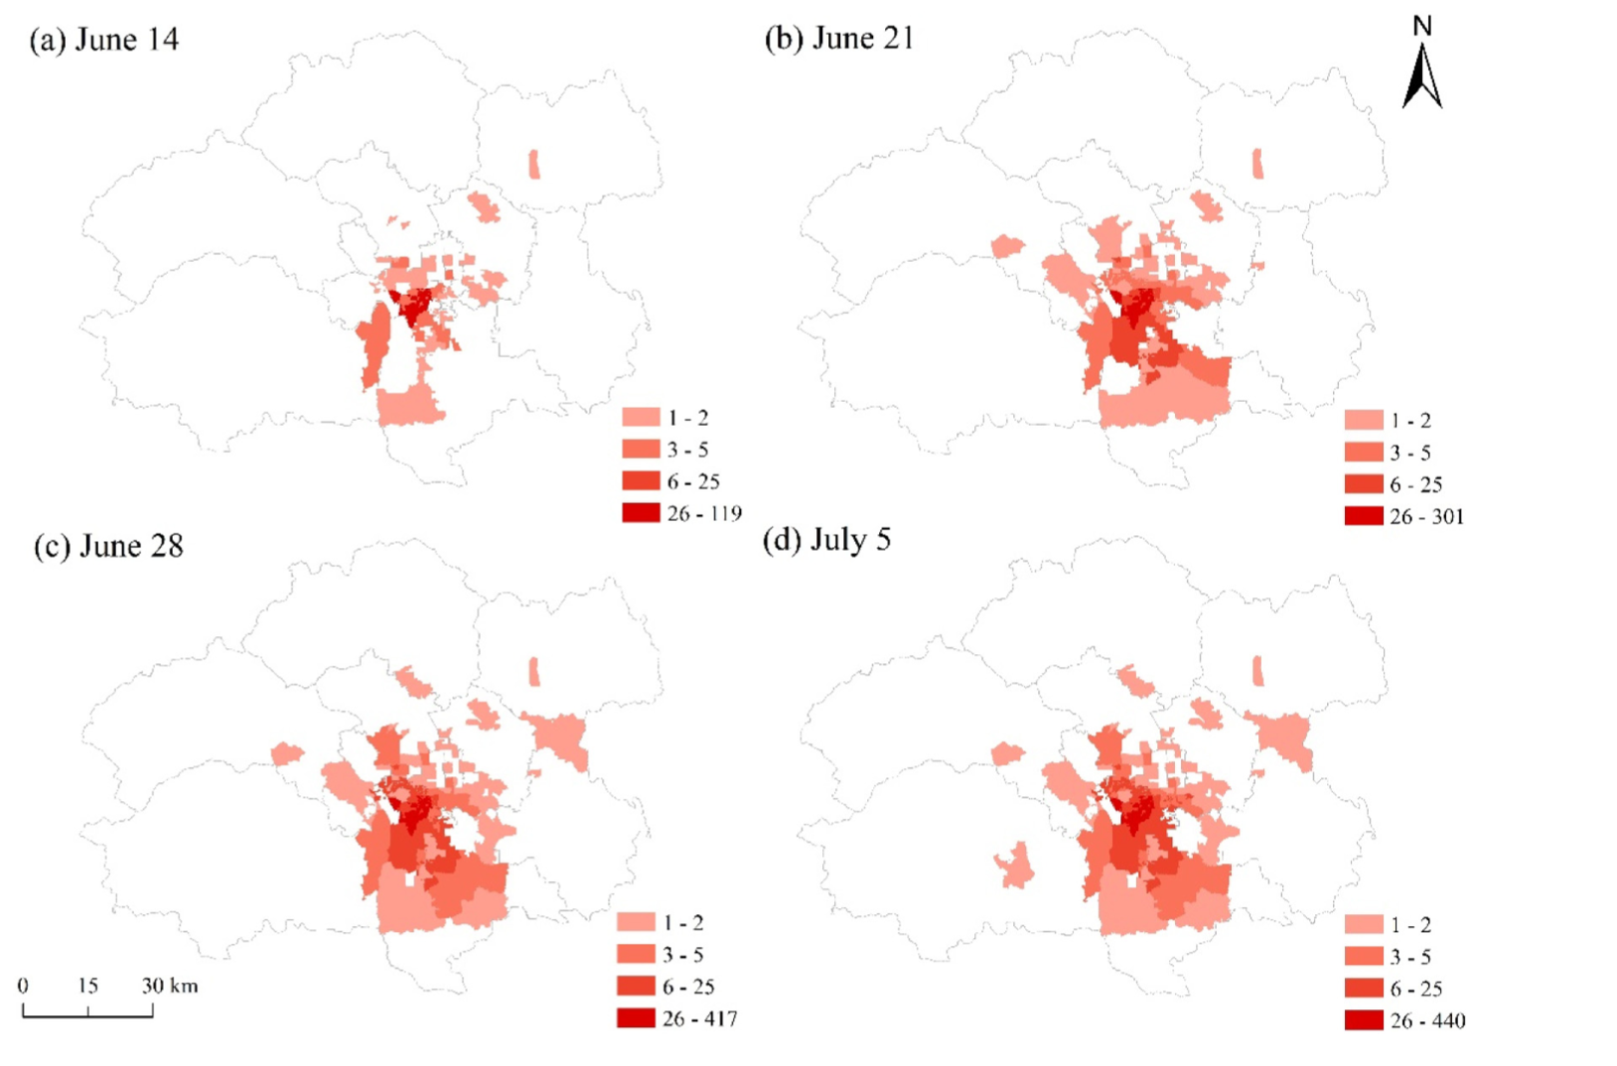
Literature review

Slide 7
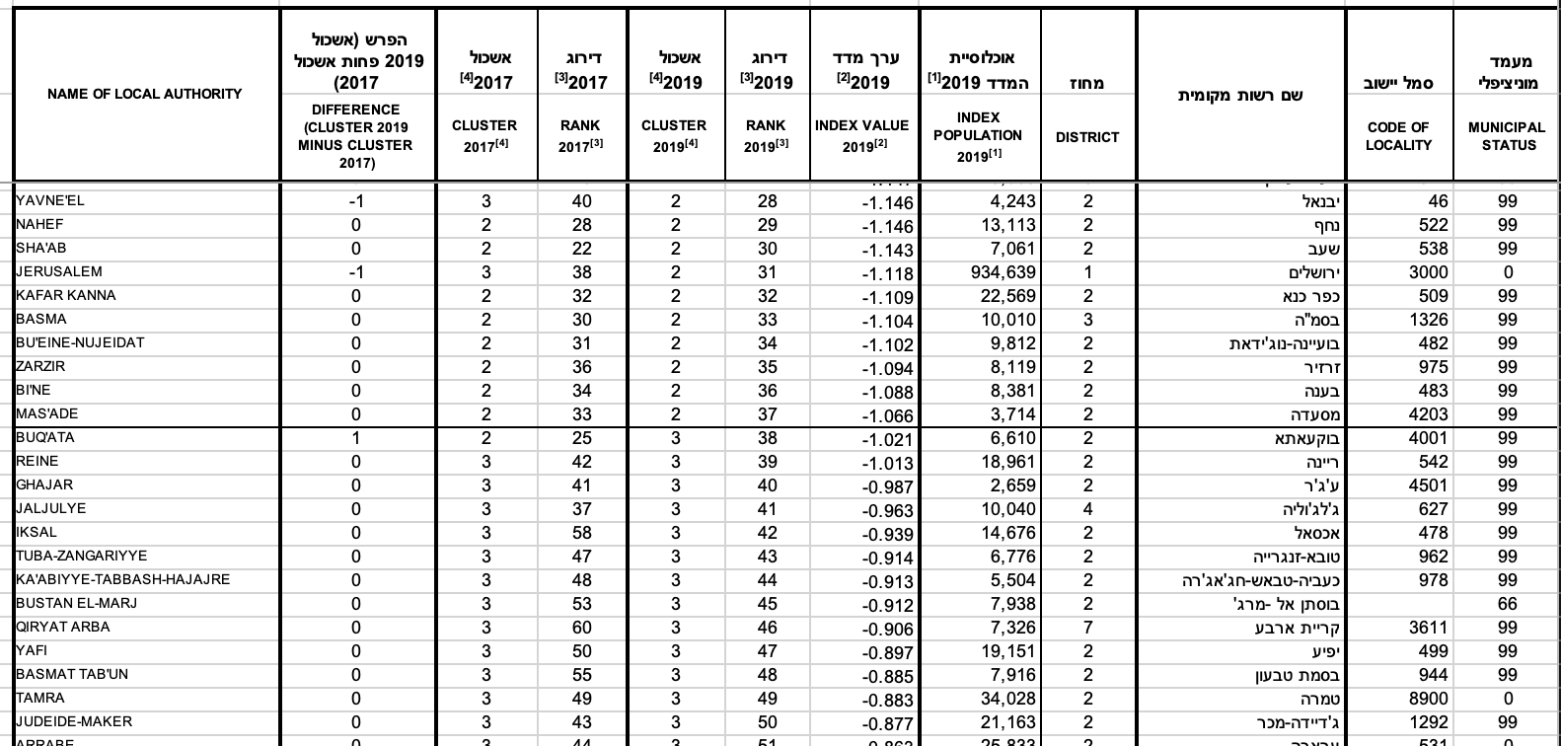
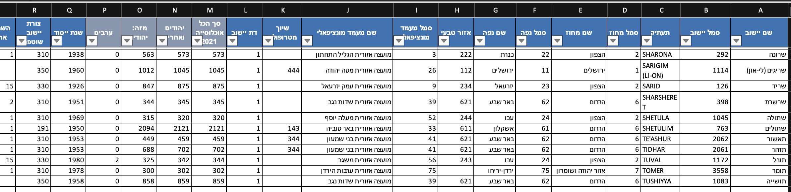
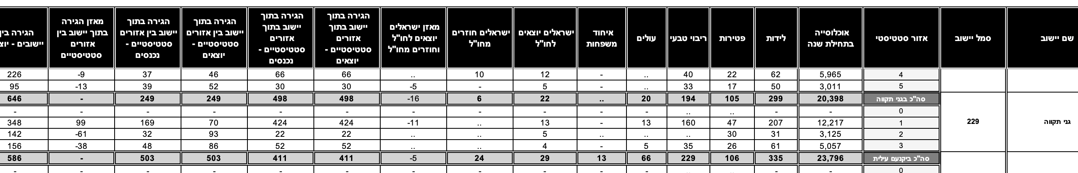
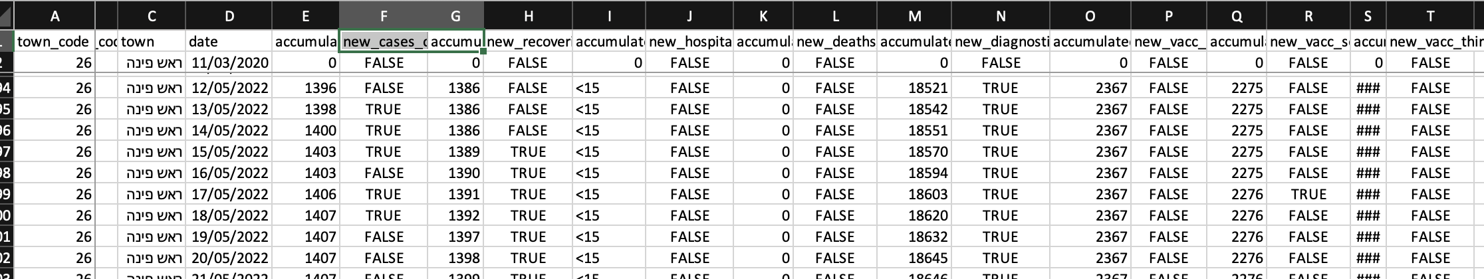
Databases overview
Data collection:
Retrieve data from the CBS of Covid -19
Retrieve data of social economic data with approximate time of survey
Retrieve data of social geo data with approximate time of survey

Slide 8
Results / desired results
We assume that there is a direct correlation between socio economical laddering and the health in the pandemic
We also azamine the coloration of geo social data and health in covid 19 (distance from health centers)

Slide 9
Bibliography
Liao, T. F., 2021. Social and economic inequality in coronavirus disease 2019 vaccination coverage across Illinois counties.
Mathieu, E., 2021. A global database of COVID-19 vaccinations.
Anon., n.d.
Gustafsson, P. E., 2022. Inequitable impact of infection: social gradients in severe COVID-19 outcomes among all confirmed SARS-CoV-2 cases during the first pandemic wave in Sweden.
Samany, N. N., 2021. The most places at risk surrounding the COVID-19 treatment hospitals in an urban environment- case study: Tehran city.
Ergo€nül, €., 2020. National case fatality rates of the COVID-19 pandemic.

